Slide 1
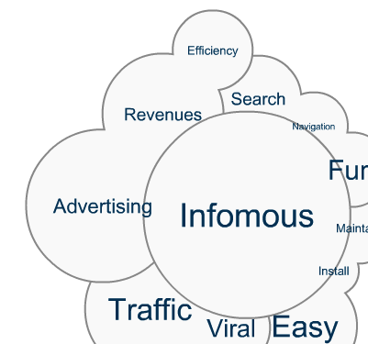
Infomous™: Visual Exploration for Yelp
Prepared by: Infomous, Inc.
Date: November 2013

Slide 2
The problem

Slide 3

Finding relevant information online is a challenge
Relevant Content

Slide 4
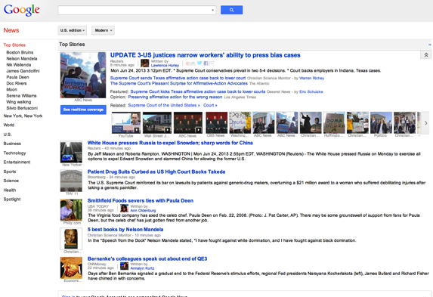
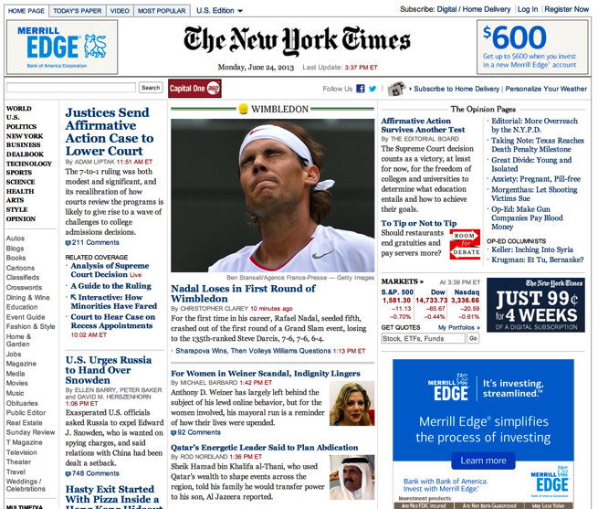
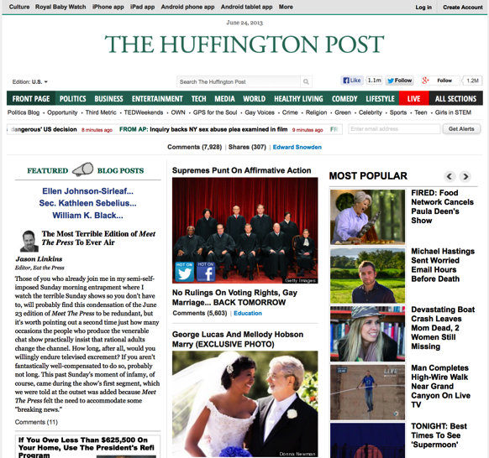
Example: what is relevant in today’s headlines?
Can you see what’s relevant to you in today’s news?

Slide 5
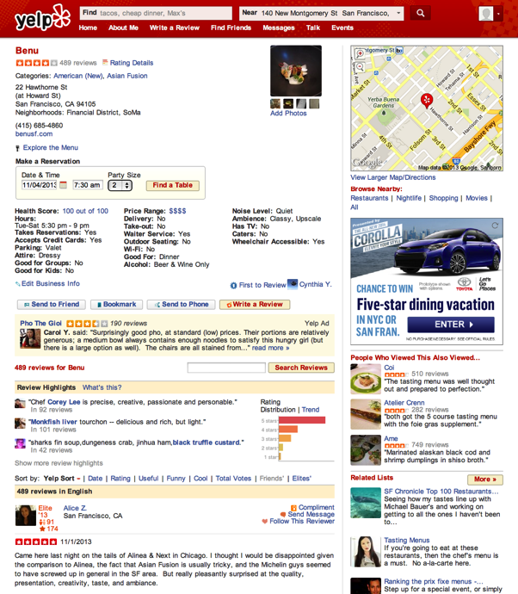
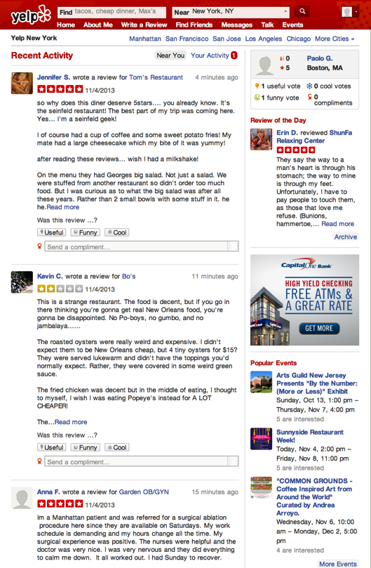
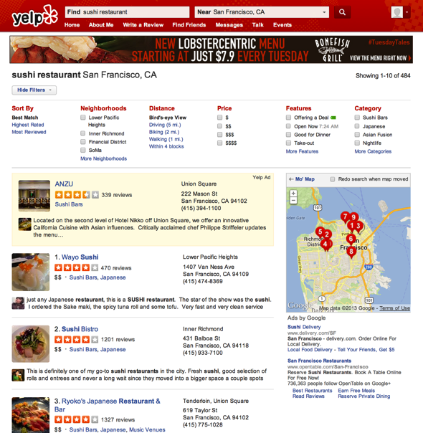
What are Yelpers saying about local businesses?

Slide 6

The solution:
Infomous™ addresses the “relevance problem” through visual exploration

Slide 7
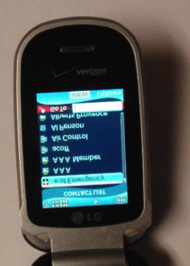

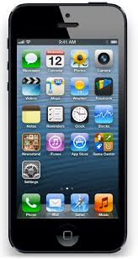

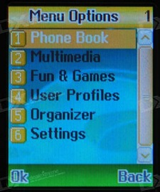
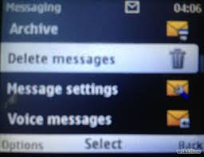
Just as Apple© made phones easy, fun and sexy...

Slide 8

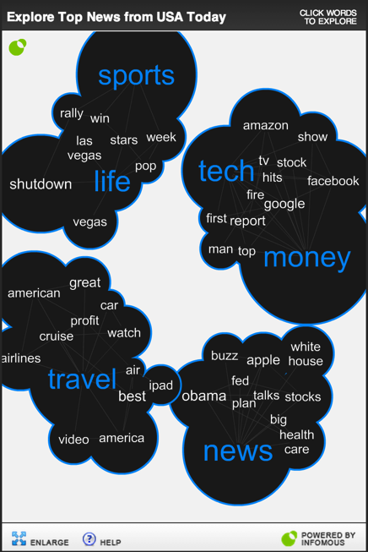
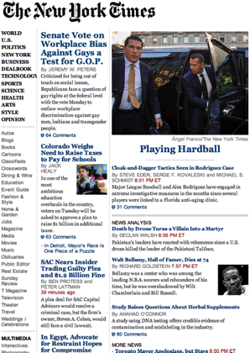
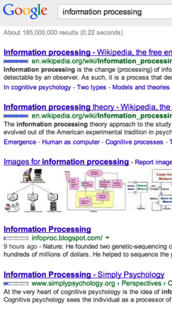
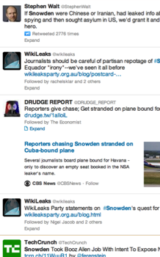
...Infomous makes online content easy, fun and sexy

Slide 9
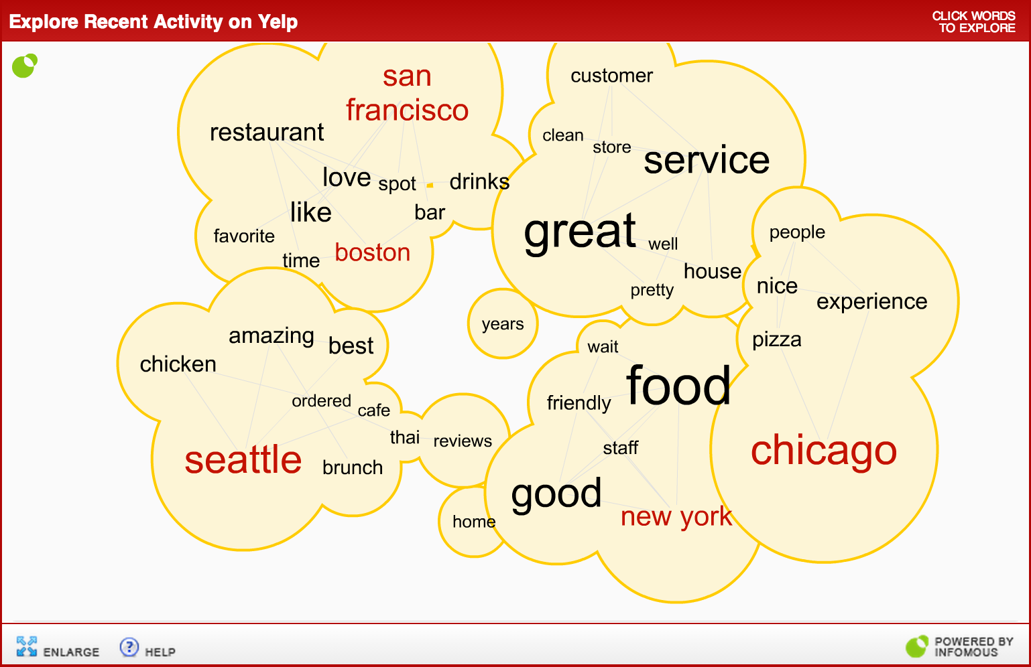
Example: “see” recent activity on Yelp...

Slide 10
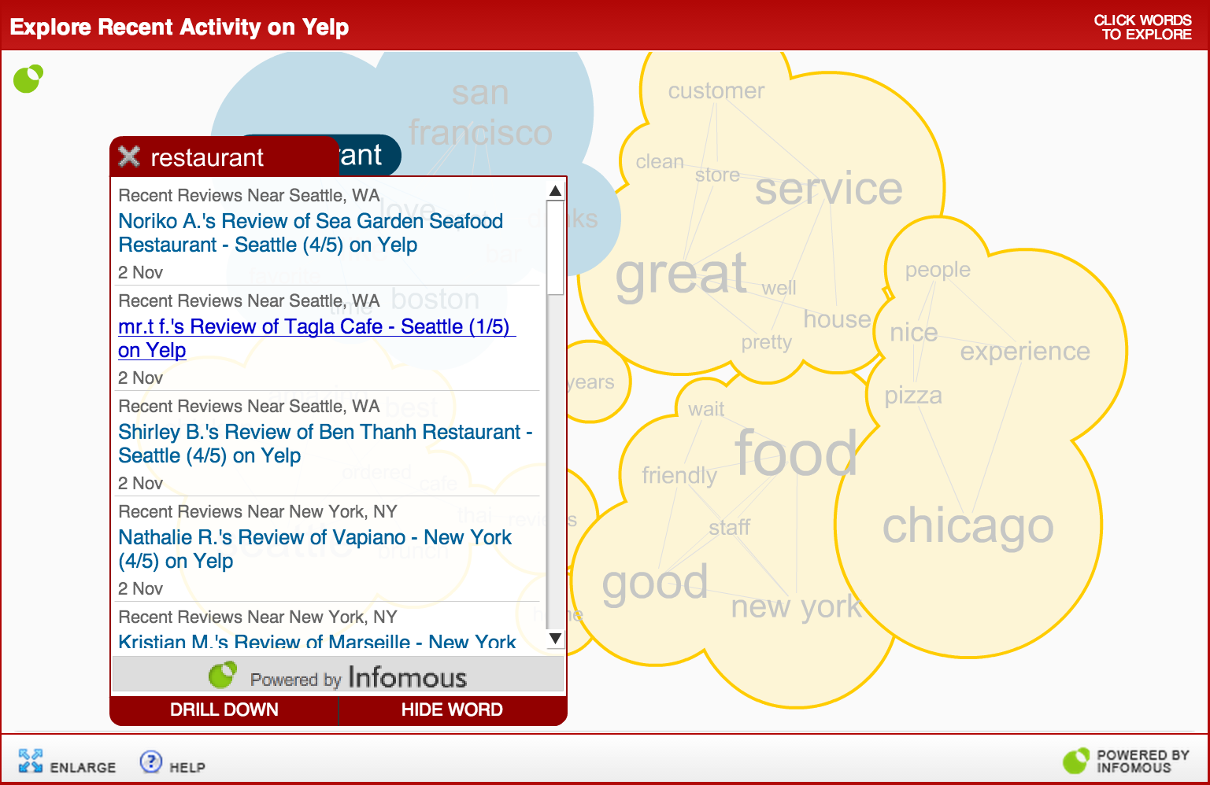
...click the words that are relevant to you...

Slide 11
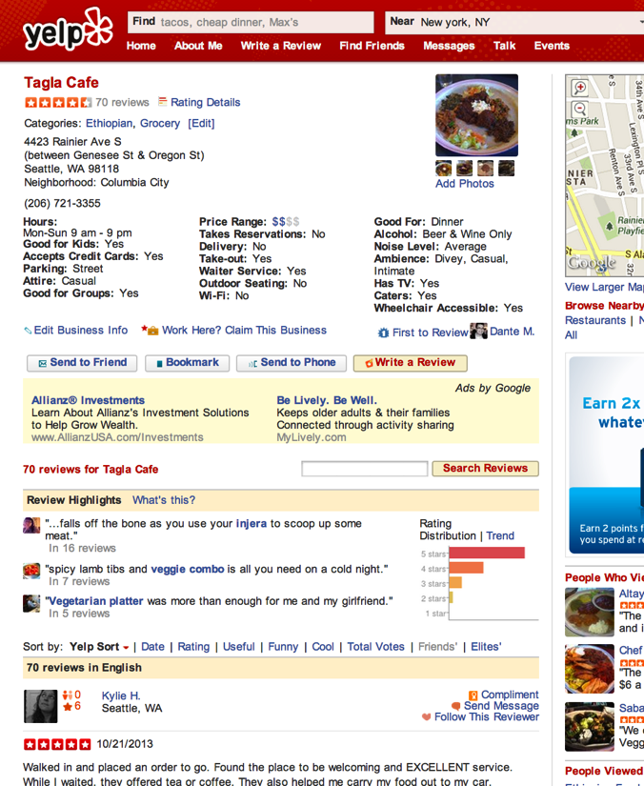

... then read the original content on Yelp.com

Slide 12
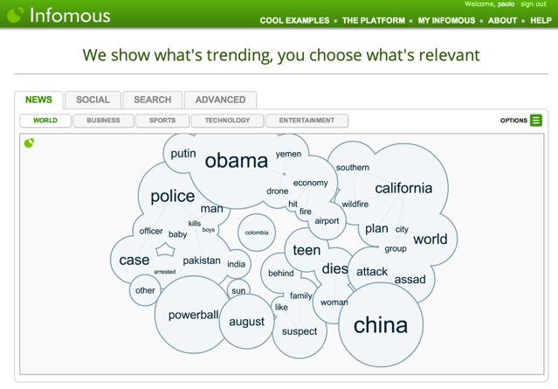
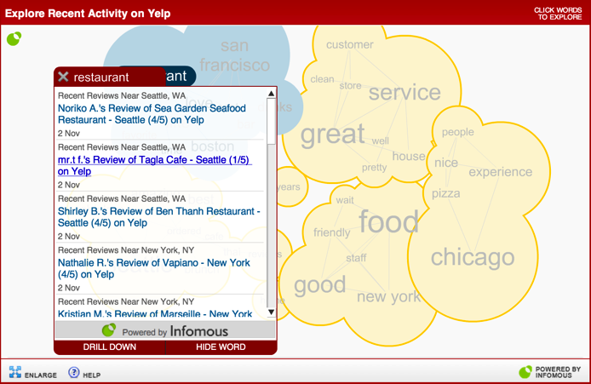
A demo is worth 100 slides
Explore News, Social, Search, ...
Explore recent Yelp activity
http://www.infomous.com/#tab=news/world
http://www.infomous.com/node/44205

Slide 13
The proof

Slide 14





















Who uses Infomous?
For links to live examples, visit http://www.infomous.com/explore/sites

Slide 15
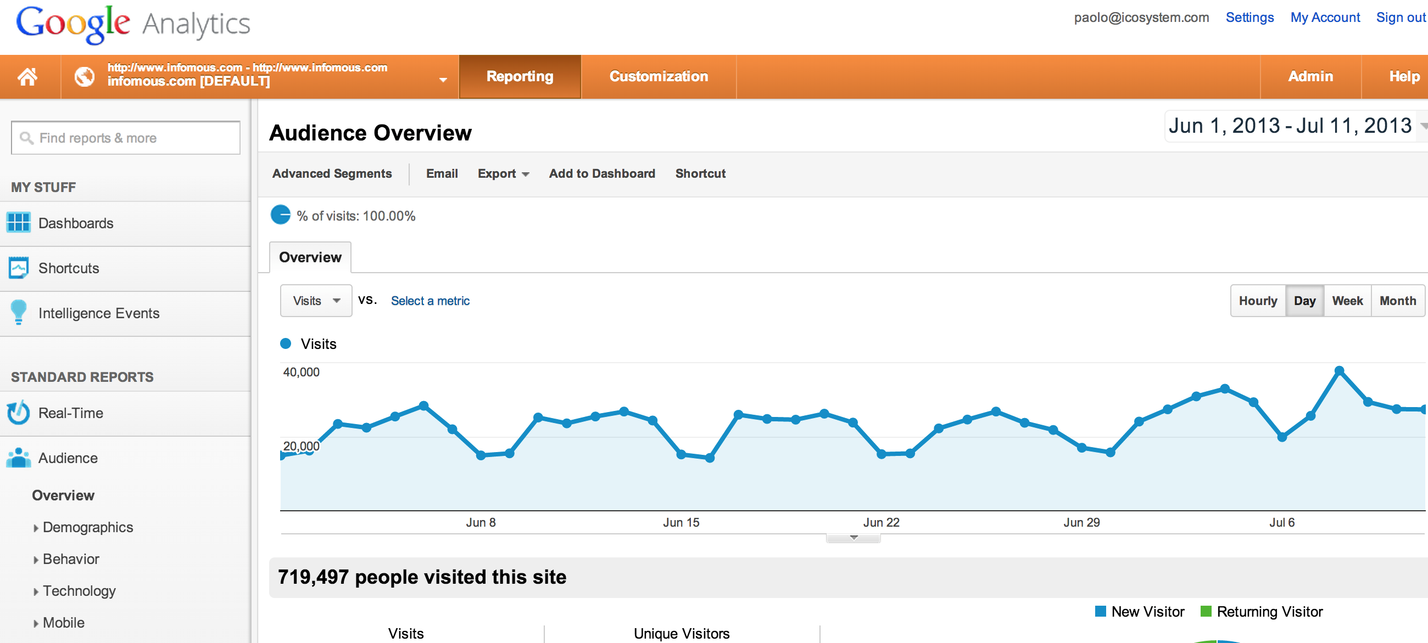
Infomous clients enjoy high engagement levels
Representative results:
15-25% interaction rates
5-10-minute increase in time on page
3-5% overall CTR to new pages

Slide 16
The business value

Slide 17
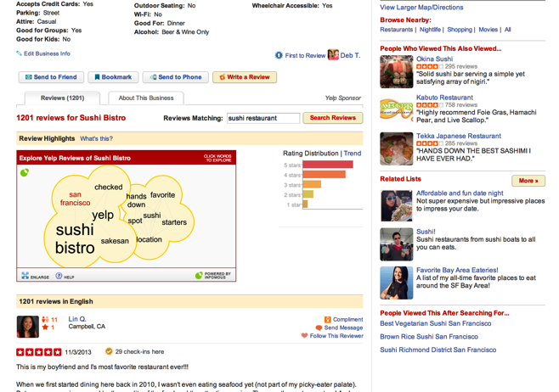
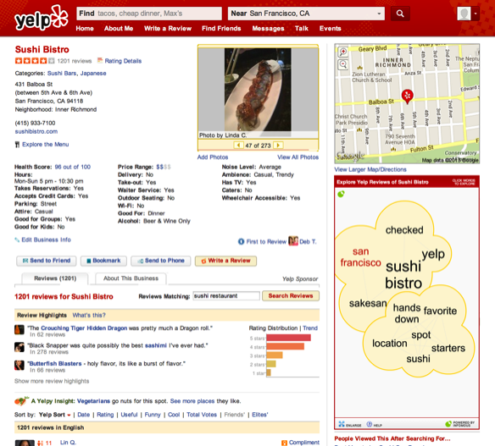
Embed Infomous to drive user engagement
Easy to embed in different sizes and positions
Robust, cloud-based technology
Minimal integration and maintenance effort

Slide 18
Monetization opportunities
In addition to driving user engagement, content circulation and site stickiness, Infomous offers three types of advertising:
Branding
Contextual ad units
Promoted ad units

Slide 19
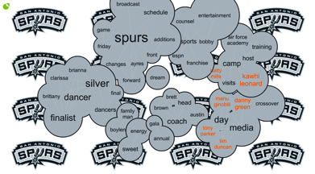
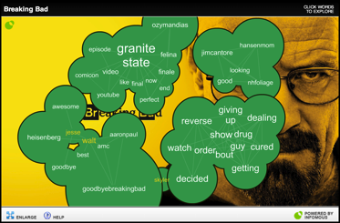
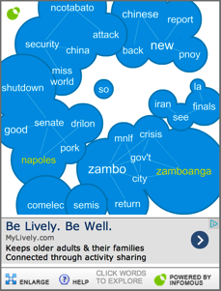
1) Branding opportunities
Cloud background image
Full-sized or tiled
Ad embedded within cloud frame, can be matched to cloud topic

Slide 20
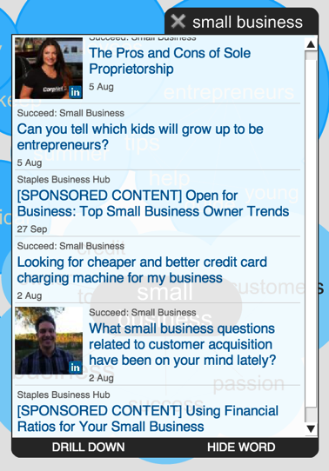
2) Contextual/native ad unit
Appears when user clicks word
One or more sponsored items interspersed with original content (labeling optional)
Contextually matched to cloud keywords
Fully configurable position and frequency within the list of links
Can be used for internal content or promotions

Slide 21
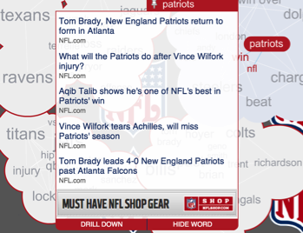
3) Promoted ad unit
Flexible format:
Text, image or text with logo (with hyperlinks or inline HTML)
Top or bottom placement
Items scroll behind it
Flexible placement:
One or more ads associated randomly with all keywords
Ads associated with specific keywords
Allows blacklisting of keywords that should have no ads
Flexible ad sources:
Sponsorships
Third-party ad networks
House ads

Slide 22
Contact information
Paolo Gaudiano, Founder and CEO
paolo@infomous.com
978-471-9129
@icopaolo

